Slide 1
Different Flavors of Computing Providing context to a first course in computing
Breaking Boundaries 2017
Christopher M. Clark
Notes:
Abstract: In 2010, the Computer Science Department at Cal Poly SLO augmented the traditional three course computer programming sequence by adding a fourth course to the beginning of the sequence. This course is not just taken by CS students, but by computer engineering students as well. The goal of this additional course is to attract and retain undergraduate students that have no prior experience in computing by providing problems that have relevance in society. Several versions of the new course were offered in parallel, and each version differed by application area. Specifically, there are 5 versions of the course taught: gaming, mobile apps, robotics, music, and computational art. Students were provided with the opportunity to choose which course they took so that pre-existing interests could be leveraged. This presentation will provide details of the curriculum and course topics. Results regarding graduation rates, GPA, and attitude towards computing will also be presented. Notably, computer engineering four year graduation rates rose by 14.6%.

Slide 2
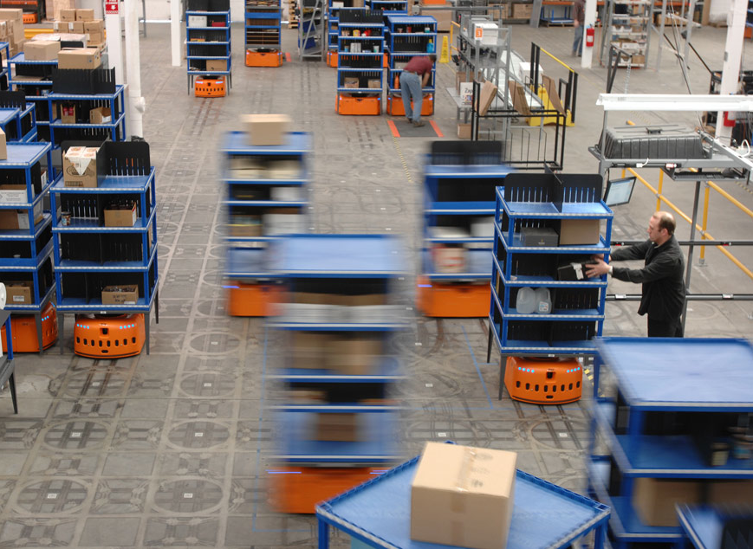
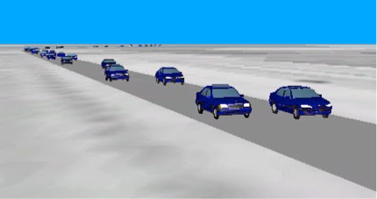
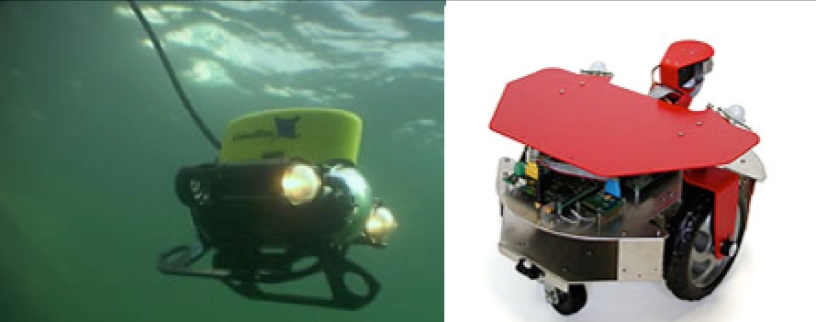
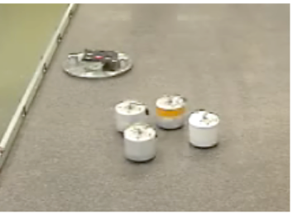
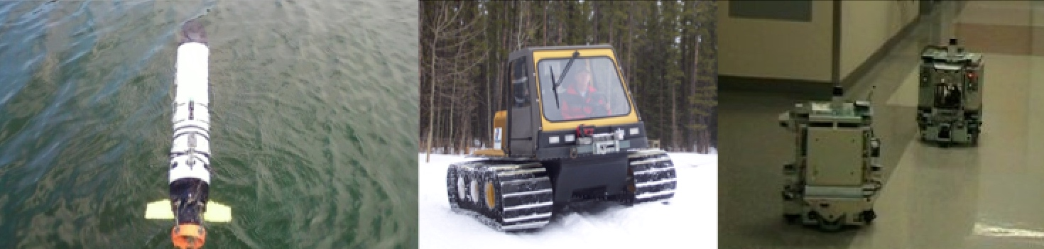
Introduction
Academia
Queen’s University
University of Toronto
Stanford University
University of Waterloo
Cal Poly, San Luis Obispo
Princeton University
Harvey Mudd College
Industry
Sterner Automation
Kiva Systems

Slide 3
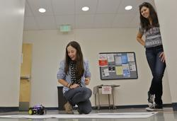
Outline
Starting Point
New Sequence
Interest Based Tracks
Themes
Assessment
Current Work

Slide 4
Starting Point
Traditional Intro to Computer programming sequence taught to Computer/Software Engineers
72 % pass rate (nationally)*
Worst course pass rate in the College
Retention of students?
Freshman Year
CSC101
CSC102
CSC103
*Failure Rates in Introductory Programming, Bennedsen
Notes:
Failure Rates in Introductory Programming
Jens Bennedsen
IT University West
Fuglesangs Allé 20
DK-8210 Aarhus V
Denmark
jbb@it-vest.dk
Michael E. Caspersen

Slide 5
New Sequence
Add to the traditional CS sequence
Focus on Applications
Using a parallel track structure
Freshman Year
Sophomore Year
…
CSC123
CSC101
CSC102
CSC103

Slide 6
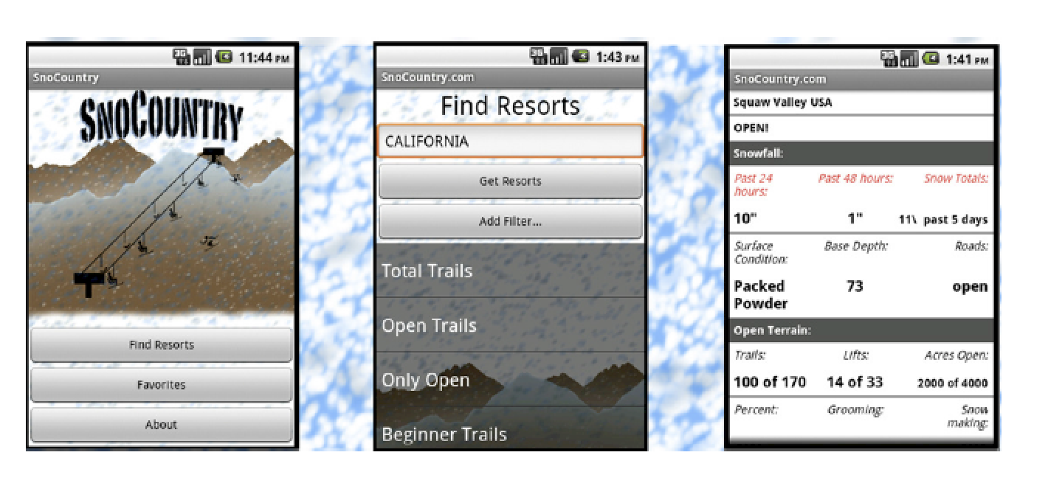
Track Structure
Each track teaches computing with a different theme
Students enroll in a track they choose*
Themes provide context to computing

Slide 7
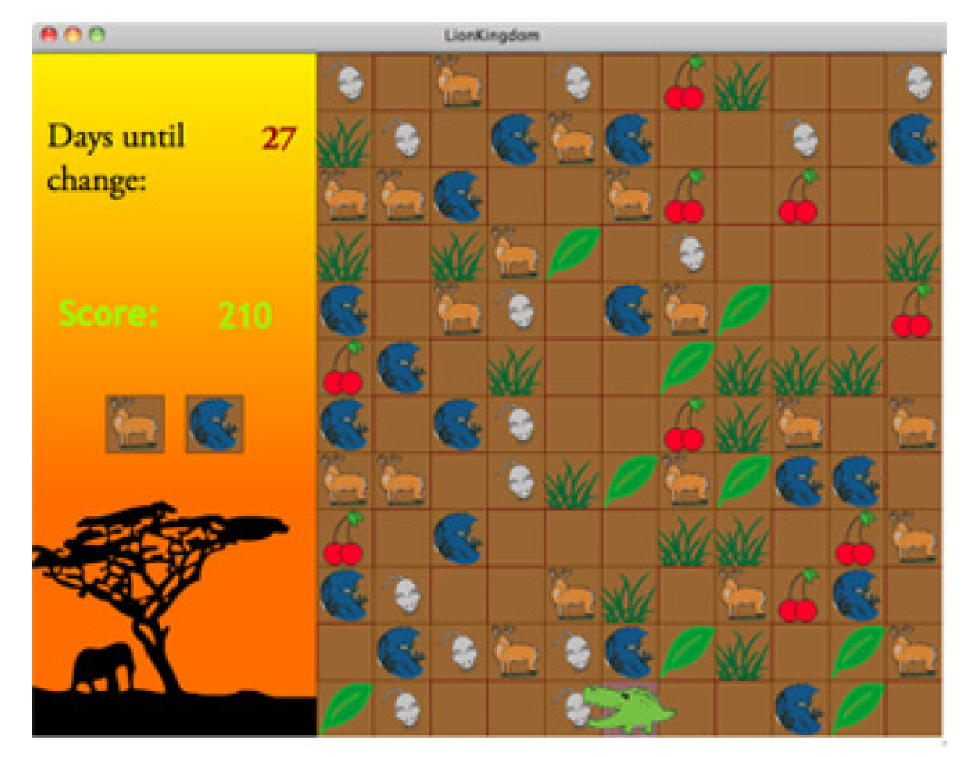
Themes
Originally four themes to choose from:
Computing in Gaming
Mobile Computing
Computing in Robotics
Computing in Music

Slide 8
Track Structure
Equal Participation
Basic Learning Outcomes
Software Development Process
Team Based Learning
Grading Scheme
Student Mentoring
Applications with external clients
All courses
Require no programming experience
Present problems without obvious solutions and promote Creativity

Slide 9
Track Structure
Equal Participation
Basic Learning Outcomes
Software Development Process
Team Based Learning
Grading Scheme
Student Mentoring
Applications with external clients
All Courses
Teach some common set of computer programming fundamentals

Slide 10
Track Structure
Equal Participation
Basic Learning Outcomes
Software Development Process
Team Based Learning
Grading Scheme
Student Mentoring
Applications with external clients
All Courses
Require a large project
Require an iterative design process, implementation, testing

Slide 11
Track Structure
Equal Participation
Basic Learning Outcomes
Software Development Process
Team Based Learning
Grading Scheme
Student Mentoring
Applications with external clients
All Courses
Have the project require teams of 4-6 students.
Give formal lecture(s) on teamwork

Slide 12
Track Structure
Equal Participation
Basic Learning Outcomes
Software Development Process
Team Based Learning
Grading Scheme
Student Mentoring
Applications with external clients
All courses
Use the same set of deliverables
Use the same grading rubric

Slide 13
Track Structure
Equal Participation
Basic Learning Outcomes
Software Development Process
Team Based Learning
Grading Scheme
Student Mentoring
Applications with external clients
All Courses
Use upper division students as mentors
Have mentors run programming workshops

Slide 14
Track Structure
Equal Participation
Basic Learning Outcomes
Software Development Process
Team Based Learning
Grading Scheme
Student Mentoring
Applications with external clients
All Courses
Have an external client outside of the realm of Computing
Have the client help determine the goal, constraints of the project.

Slide 15
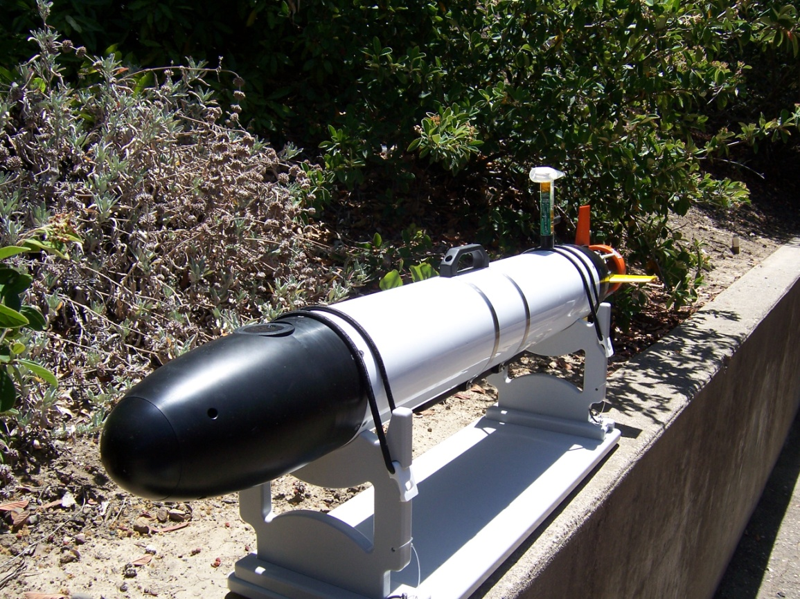
Themes
Computing in Robotics
Motivate learning of computing skills with ocean sampling task
The task requires:
Intro to ocean sampling
Computer programming
Algorithms
Physical implementation on an Autonomous Underwater Vehicle

Slide 16


Slide 17
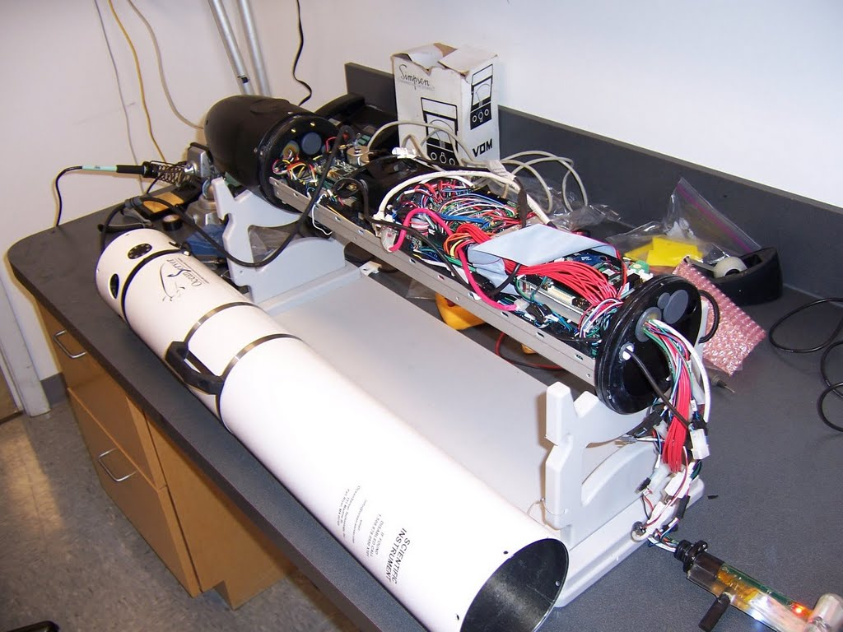
Themes
Computing in Robotics
First half of quarter
Introductory level lectures
In class labs: AUV task to complete
Midterm Exam

Slide 18

Themes
Computing in Robotics
Second half of quarter
Team Formation
Project introduction
Project work
Final deployments
AUV Rescues!
Presentations
Final Exam

Slide 19
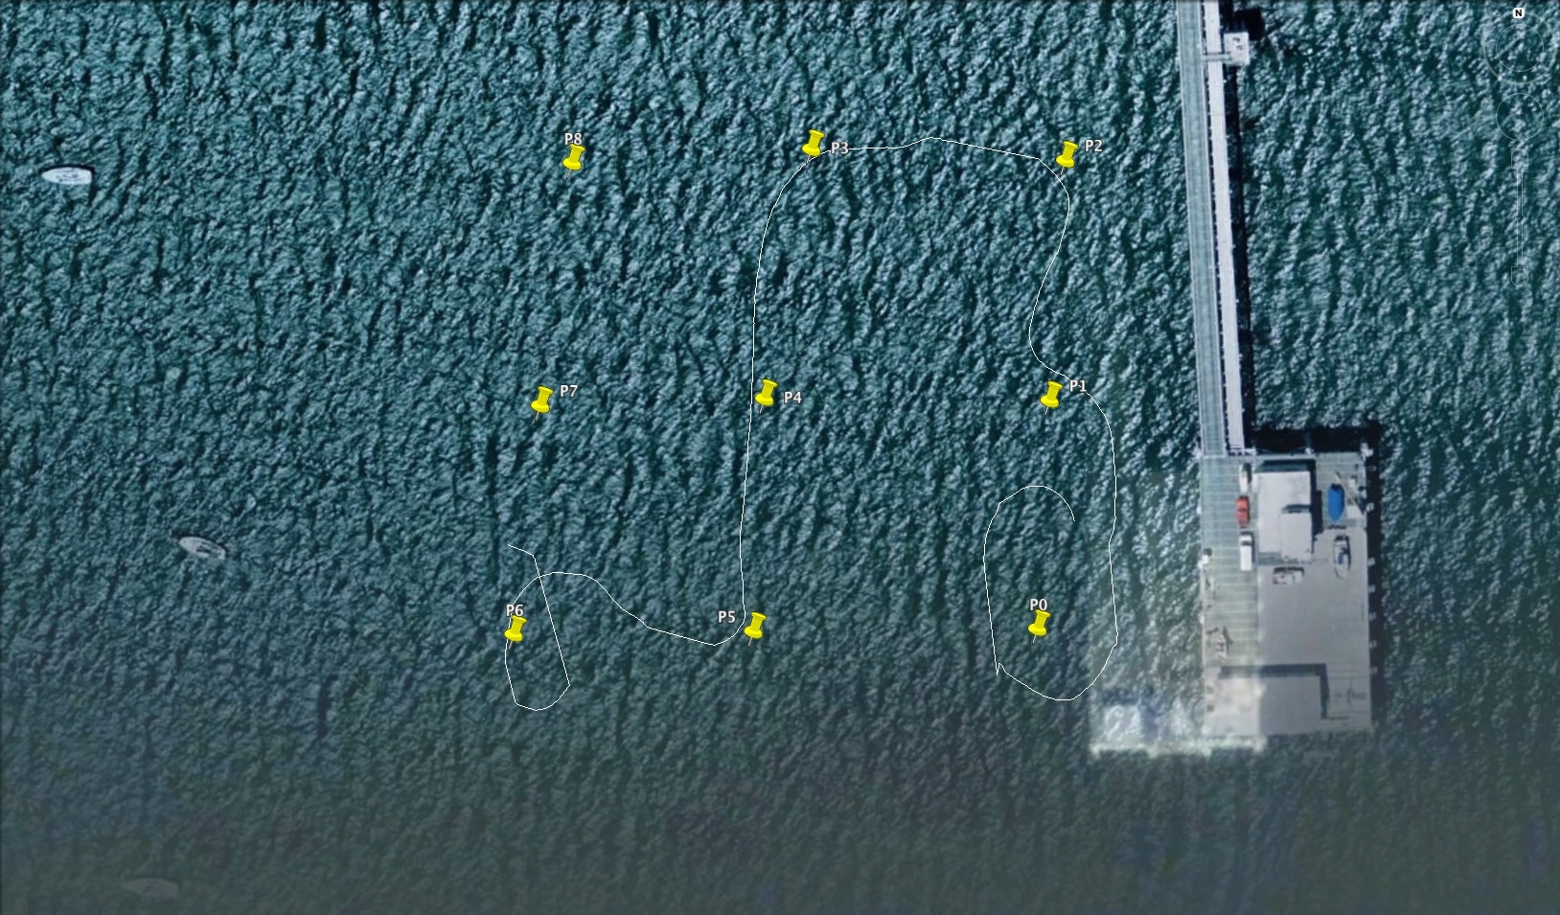
Themes
Computing in Robotics
Motivate learning of computing skills with ocean sampling task

Slide 20
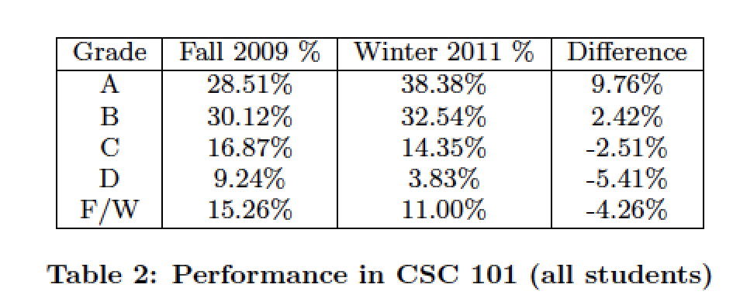
Assessment
Grades
Retention
Graduation Rates

Slide 21
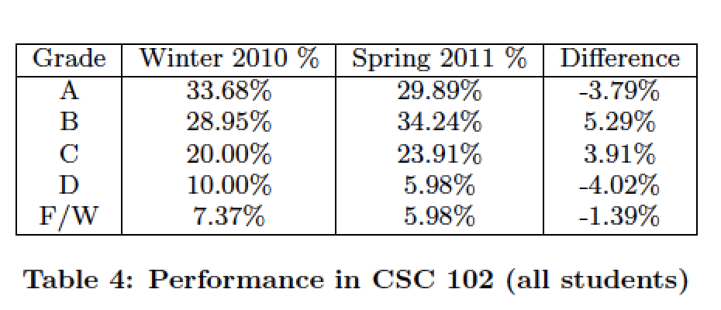
Assessment
Grades
Retention
Graduation Rates

Slide 22
Assessment
Grades
Retention
Graduation Rates
 | CS101 Enrollment | CS102 Enrollment | Percent Retained
Without CS123 | 249 | 190 | 76.3 %
With CS123 | 209 | 184 | 88.0 %

Slide 23
Assessment
Grades
Retention
Graduation Rates
Four Year Graduation Rates | Computer Science Graduation Rate | Computer Engineer Graduation Rate
Without CSC123 | 17% | 22%
With CSC123 | 29% | 33%

Slide 24
Assessment
Grades
Retention
Graduation Rates
Five Year Graduation Rates | Computer Science Graduation Rate | Computer Engineer Graduation Rate
Without CSC123 | 52% | 47%
With CSC123 | 60% | 61%

Slide 25
Assessment
Grades
Retention
Graduation rates
Attitudes
Of those that did not take CPE123, only 39% “strongly agreed" that they were excited about CS
Of those who did take CPE123, 47% strongly agreed "that they were excited about CS.

Slide 26
Current Work
Additional Theme on Computer Graphics
Comparison of different themes
Work at Mudd?

Slide 27
Questions?
www.hmc.edu/lair

